Slide 1
Machine Learning
Quiz 2

Slide 2
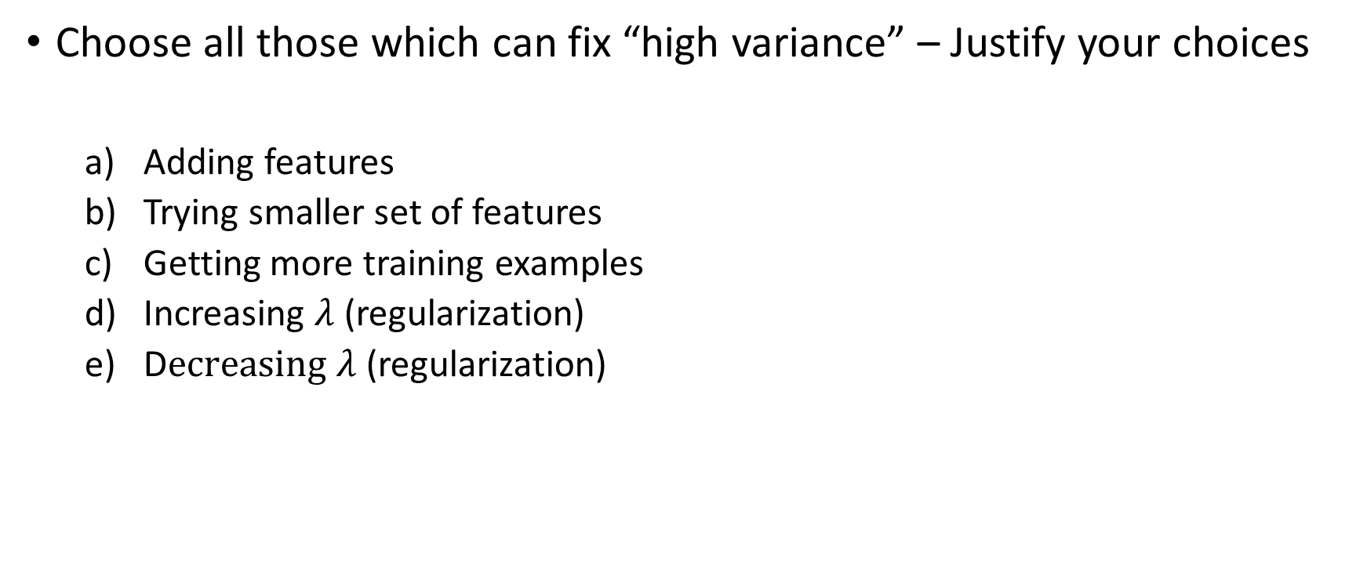
Question 1 (1 Point)
Choose all those which can fix “high variance” – Justify your choices
Adding features
Trying smaller set of features
Getting more training examples
Increasing $λ$(regularization)
D$ecreasing λ$(regularization)
Notes:
To fix a variance, we can try to limit a model’s flexibility. Thus we can use
(b) Reducing features through subset selection
(d) Increase the affect of regularization, which in turn reduces fexibility
Even if a student selects just one of them, give full points.

Slide 3
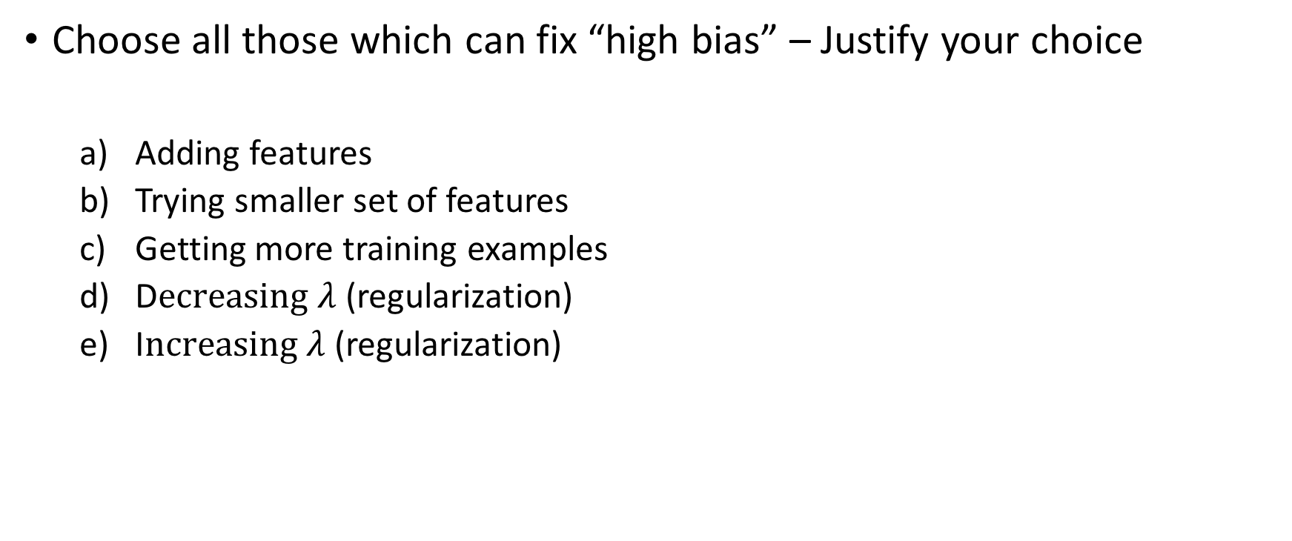
Question 2 (1 Point)
Choose all those which can fix “high bias” – Justify your choice
Adding features
Trying smaller set of features
Getting more training examples
D$ecreasing λ$(regularization)
I$ncreasing λ$(regularization)
Notes:
It is the opposite of the previous task.
(a)
(d)
Once again, give points even if one of them is selected

Slide 4
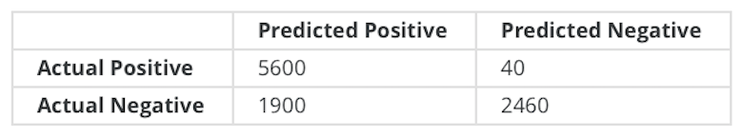
Question 3 (1.5 Point)
Suppose a binary classifier produced the following confusion matrix
Calculate recall
Calculate precision
Is this classifier better than the majority classifier? Why?
Is this an optimistic or a pessimistic classifier? Why?
Notes:
5600/5640
5600/(5600+1900)
Yes, because it did not blindly predict all negatives as positives (which is the majority class)
Optimistic as recall is high

Slide 5
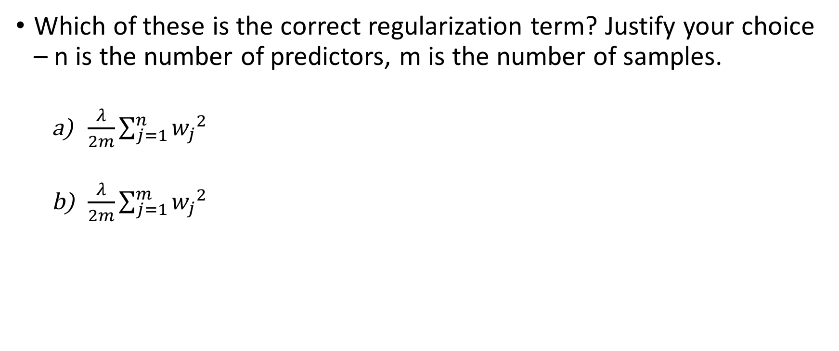
Question 4 (1 Point)
Which of these is the correct regularization term? Justify your choice – n is the number of predictors, m is the number of samples.
$\frac{λ}{2m}\sum_{j=1}^{n}{{w_{j}}^{2}}$
$\frac{λ}{2m}\sum_{j=1}^{m}{{w_{j}}^{2}}$
Notes:
a) As we have the same number of weights as the number of predictors

Slide 6
Question 5 (1 Point)
We are given a dataset consisting of sales (in number of units) of an item and its (price in dollars). We want to build a model on this data to estimate sales of the item using its price. We apply quadratic regression with the following results
Based on the results of the regression analysis, which of the following sketches approximately describes the relationship between the response and the predictor? Why?
Parameters | Values | t-value | p-value
Intercept | 7990 | 11.3 | 0.000
Price | -10660 | -9.26 | < 0.0001
Price2 | 3522 | 8.06 | < 0.0001
(a)
(b)
(c)
(d)
Sales
Sales
Sales
Sales
Price
Price
Price
Price
Notes:
(d) P-value for quadratic term is close to 0, thus the relationship is non-linear, and the slope is negative so sales decreases as price increases but nonlinearly.

Slide 7
Question 6 (1 Point)
Setting k = 1 in KNN will result in “high bias” or “high variance”? Justify your choice.
Notes:
High variance, as we have only a single neighbor to make a decision and a change in it will change the result.

Slide 8
Question 7 (1.5 Points)
Solve for the equations for weight updates in gradient descent for logistic regression when using L2 regularization.
Notes:
Just follow their work, and if they are going in the right direction give them full points

Slide 9

Question 8 (2 Points)
We said in the class that in classification problems the vector $w=[w_{1} w_{2}$ $⋯]$is perpendicular to the separating hyperplane. Prove this statement. Hint: Use the equation of the separating hyperplane, and solve for two points $x_{1}$and $x_{2}$ on it.
Notes:
wx + b = 0
wx1 + b = 0 (1)
wx2 + b = 0 (2)
Subtracting (2) from (1)
w.(x1 – x2) = 0
Dot product is 0, since x1-x2 lies on plane, and since this is true for any x1 and x2, this means w is perpendicular to the plane.
Just follow their work, and if they are going in the right direction give them full points.

